Slide 1
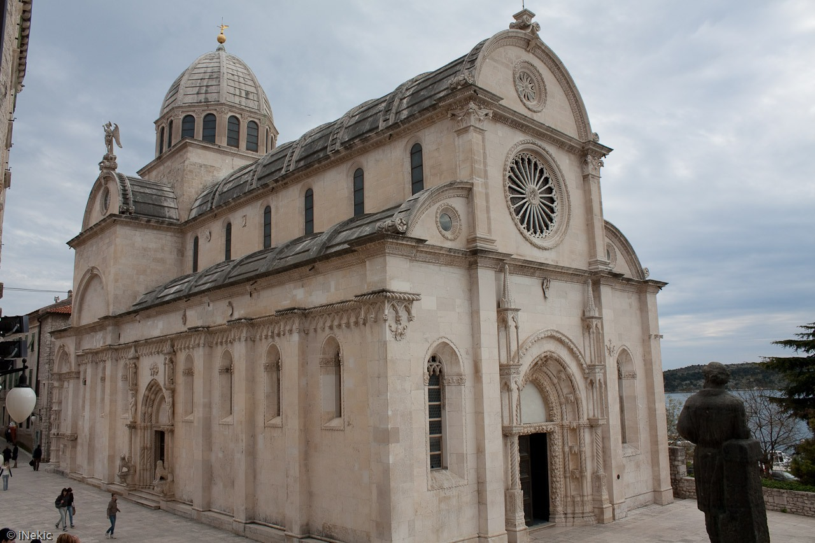
The Cathedral of St.Jacob

Slide 2
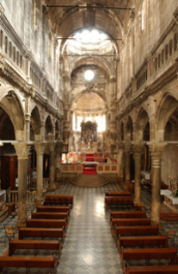
The cathedral of St. Jacob is the most valuable architectural monument in Croatia, built during the 15th and the 16th century
It represents a unique monument of the European sacral architecture.

Slide 3
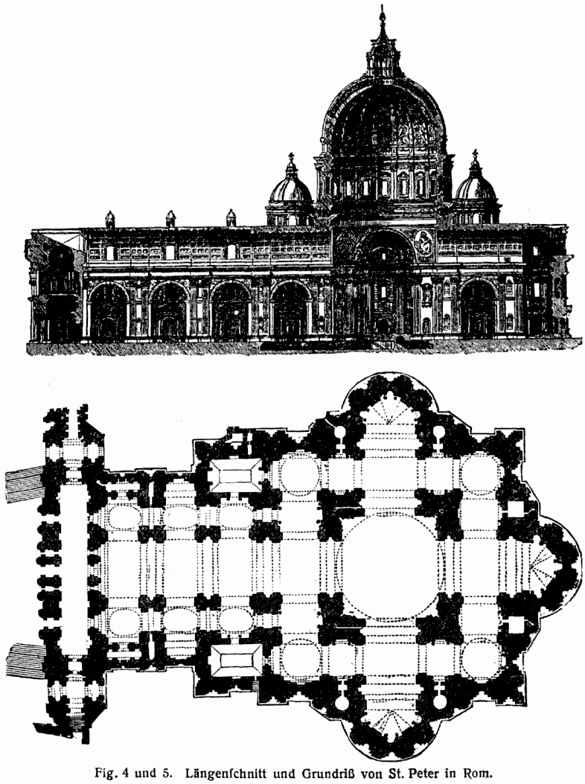
It is the only cathedral in the whole of Europe constructed entirely of stone. No wooden architectural elements were used for its building.

Slide 4
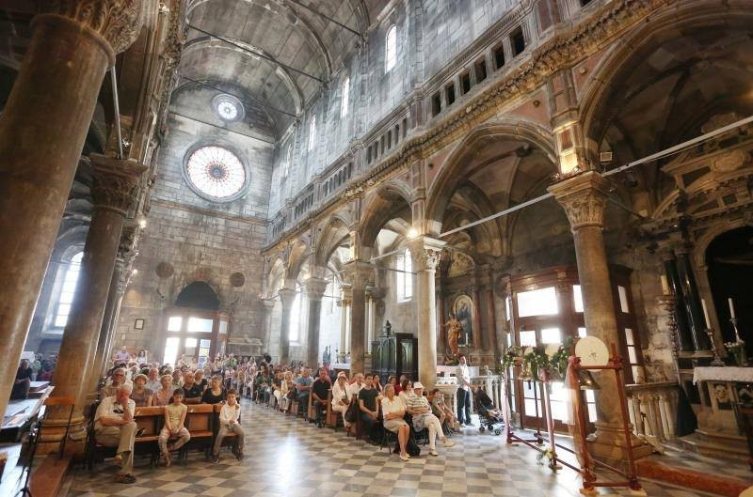
The cathedral was built on the south side of the cities old central square. The idea of building a cathedral dates back to 1298 when Sibenik gained its own diocese and the status of a city.

Slide 5
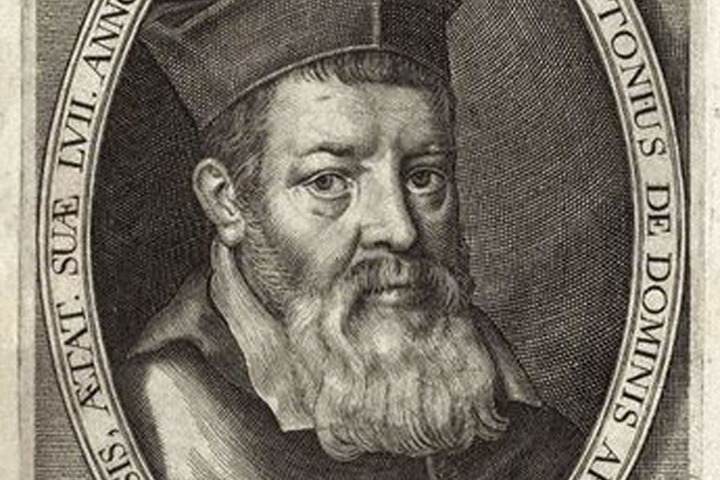
The construction of the Cathedral of St. Jacob began in 1431 in the Gothic style
In 1475 the work was entrusted to Niccolo Giovanni Fiorentino that continuous the work in the Renaissance style
In 1505 after his death, the building was completed by
Venetian craftsmen

Slide 6
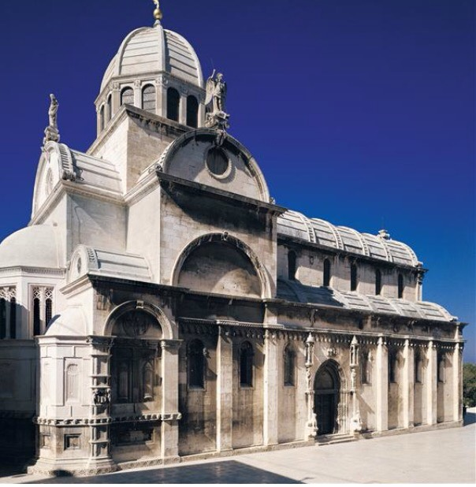
The Cathedral of St James is the fruitful outcome of considerable interchanges of influences between the three culturally different regions of Northern Italy, Dalmatia, and Tuscany in the 15th and 16th centuries.

Slide 7
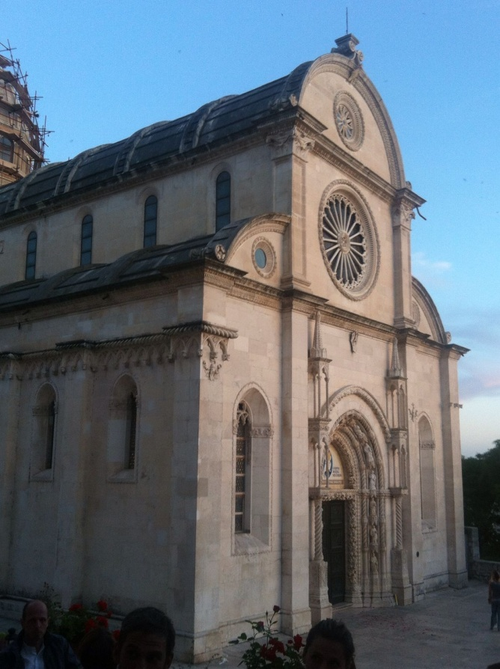
The structural characteristics of the Cathedral of St James in Šibenik make it a unique and outstanding building in which Gothic and Renaissance forms have been successfully blended.

