Slide 1
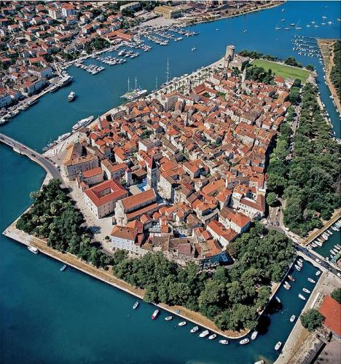
Trogir
Marta & ella 7.d

Slide 2
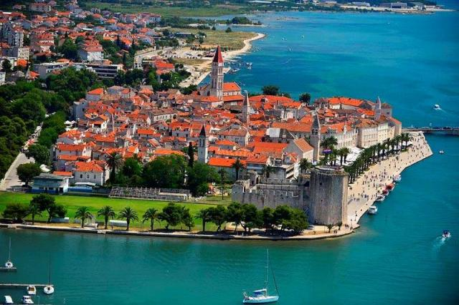
O Trogiru:
City of Trogir was founded in the 3rd century BC, under the influence of Greek colonists from the island of Vis
It is situated on a small island between the Croatian mainland and the island of Čiovo
The patron of Trogir is John of Trogir.

Slide 3
UNESCO:
UNESCO recognised its value in 1997 and listed Trogir as a World Heritage Site.
The most important sites include:
The Cathedral with the Portal of Master Radovan
City Hall Loggia
A small church of St. Barbara
The Fortress Kamerlengo
The big and small palaces Cipiko

Slide 4
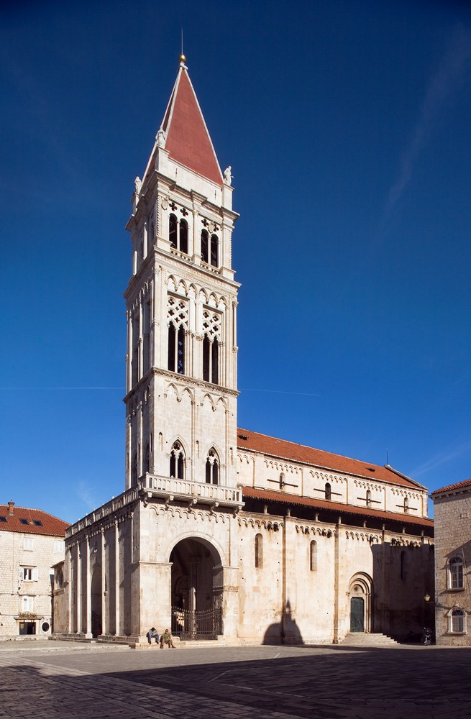
St Lawrence Cathedral
One of the most visited sites in Trogir
The official construction stated in 1213. and is a Romanesque gothic basilica.
It is dedicated to St. Lawrence but it is better known as St. John's Cathedral after bishop John
The most significant work of the Romanesque-Gothic style in Croatia is the Portal of St Lawrence Cathedral done by Master Radovan in 1240

Slide 5
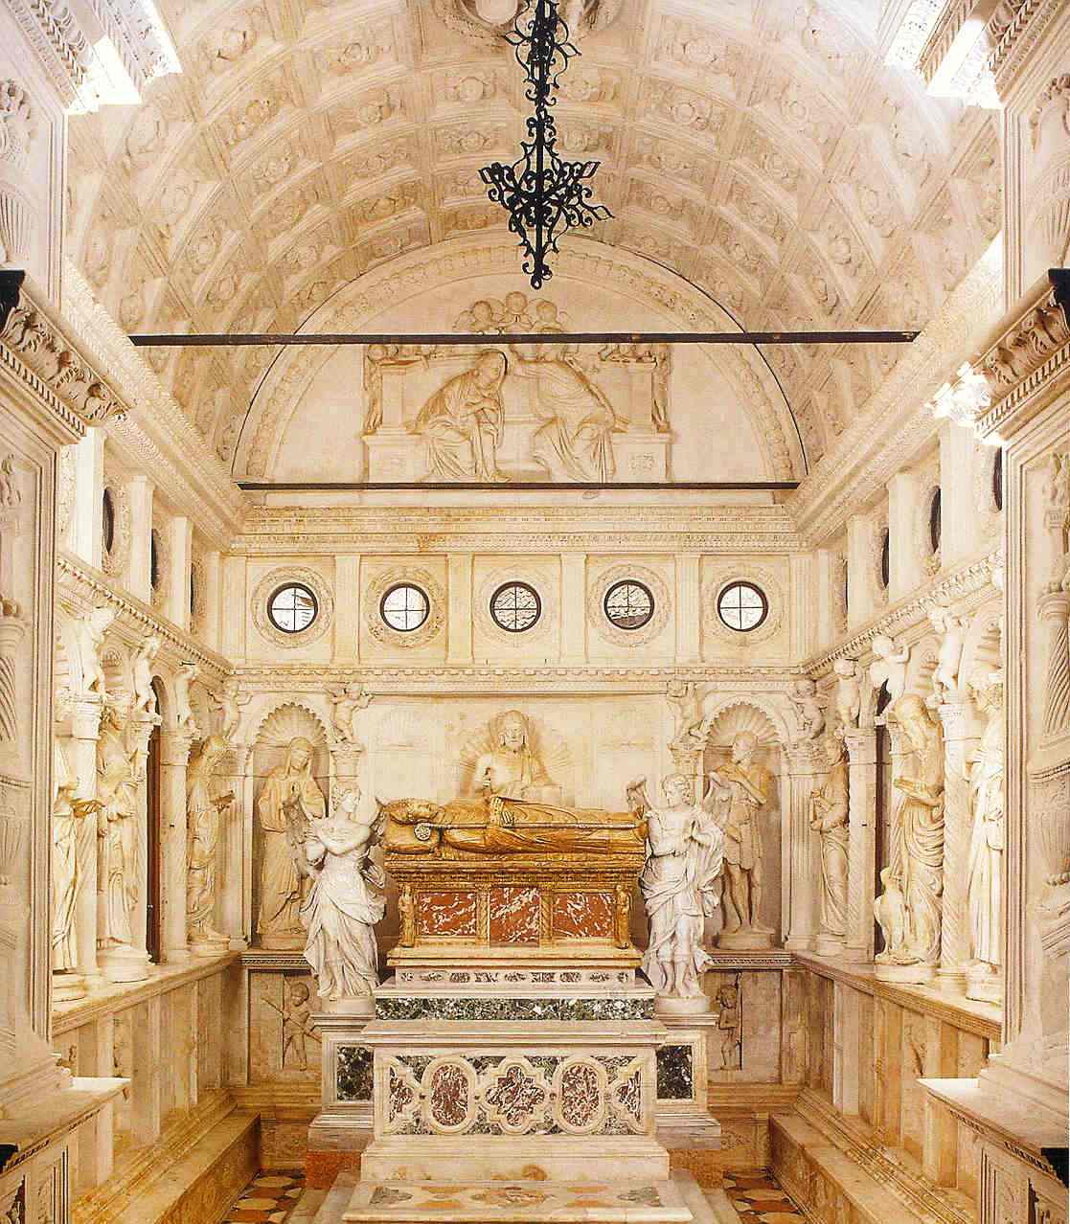
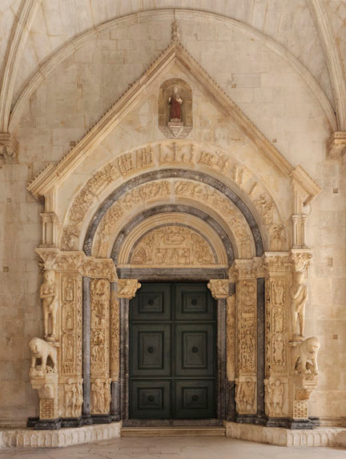
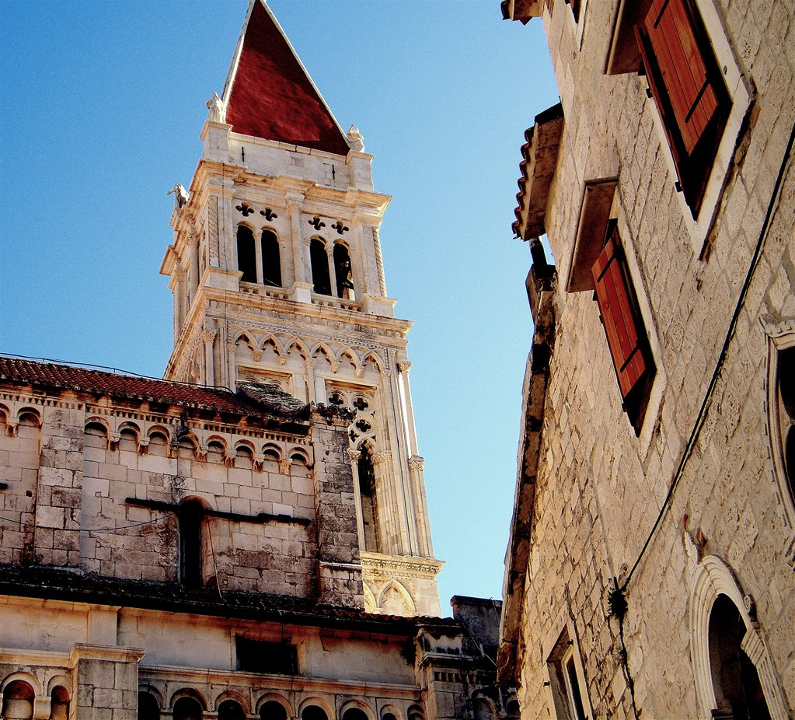
Interior of the Cathedral
The Portal of Master Radovan
A bell tower

Slide 6
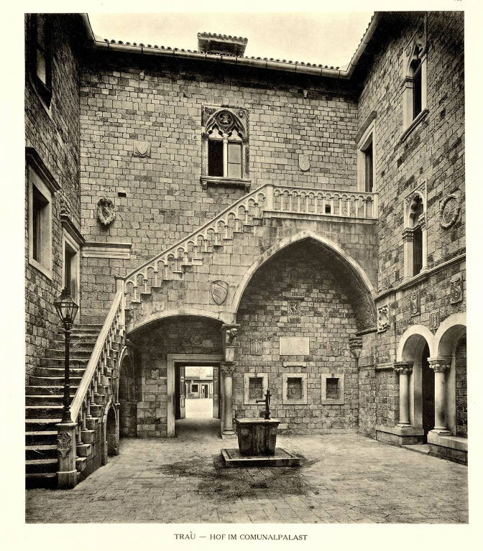
City Hall
Was first mentioned in the thirteenth century and was the centre of political power in Trogir and a place for different public discussions
Mostly built in the fifteenth and sixteenth century, it has kept the same purpose until today as an administrative centre.
During history it was also a place for theatre where different royal families had its emblems marking their spots in the theatre

Slide 7
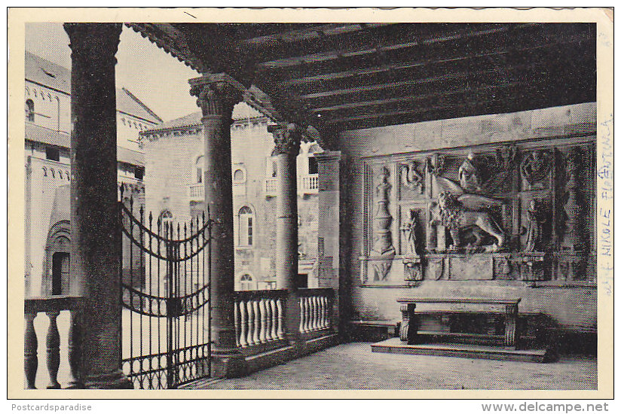
City loggia
It was first mentioned in 1311.
Loggia was used as a public property, as a hideaway and a court room.
It served a purpose as temporal custody for petty criminals.
Over time, it has also been used as a place for different negotiations and as a sales location
The southern part of the loggia has the Ivan Mestrovic relief which shows the duke Peter Berislavic.

Slide 8
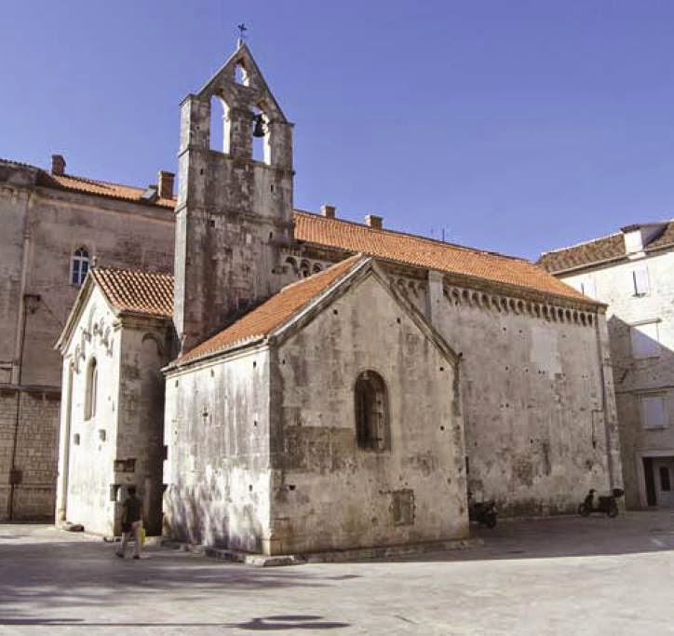
St.Barbara church
Saint Barbara is the oldest preserved Croatian church in Trogir
It was built in the 11th century

Slide 9
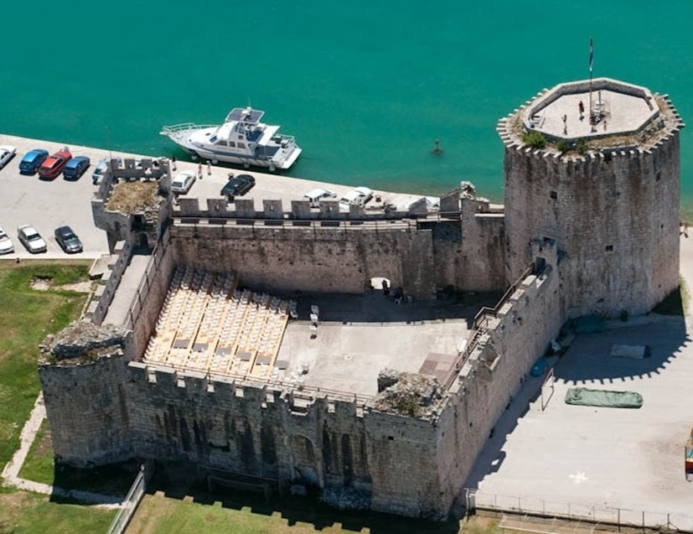
The fortress Kamerlengo
It was built from 1420 to 1437
Its main purpose was to accommodate the Venetian army fleet
Nowadays it is a unique location for the different events and concerts

Slide 10
The end

