Slide 1
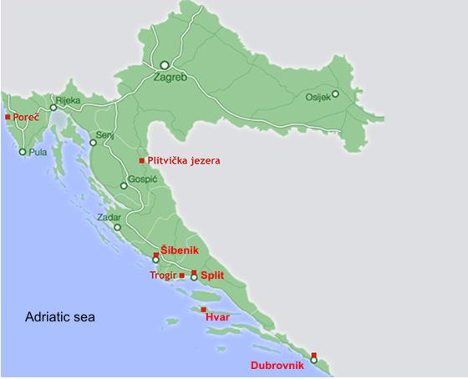

Slide 2
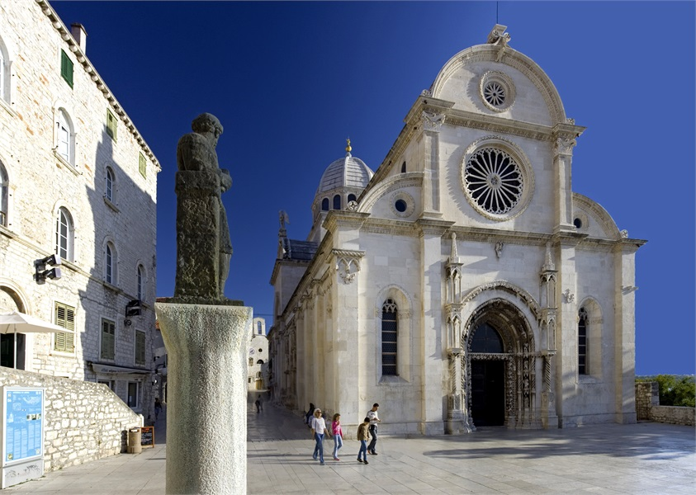
The Cathedral of St. James in Šibenik
Back to Map

Slide 3
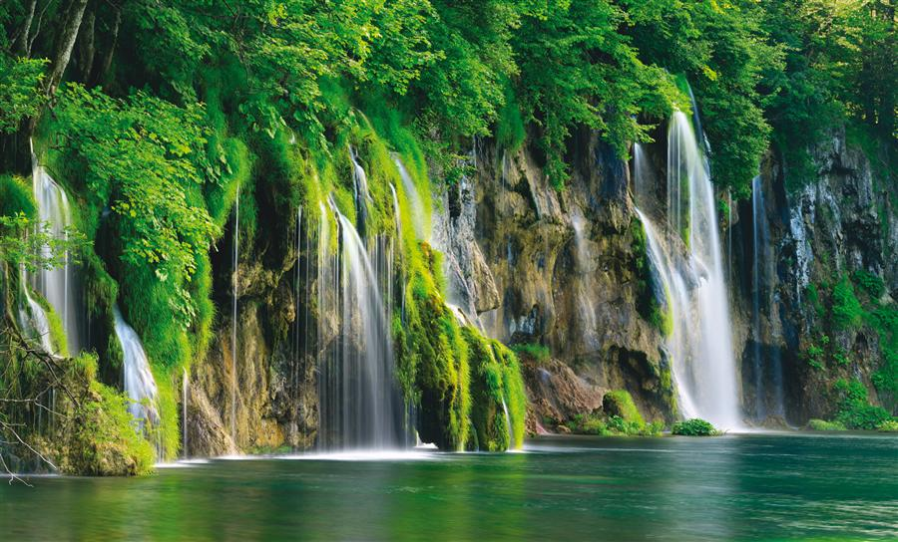
Plitvice Lakes National Park
Povratak na kartu

Slide 4
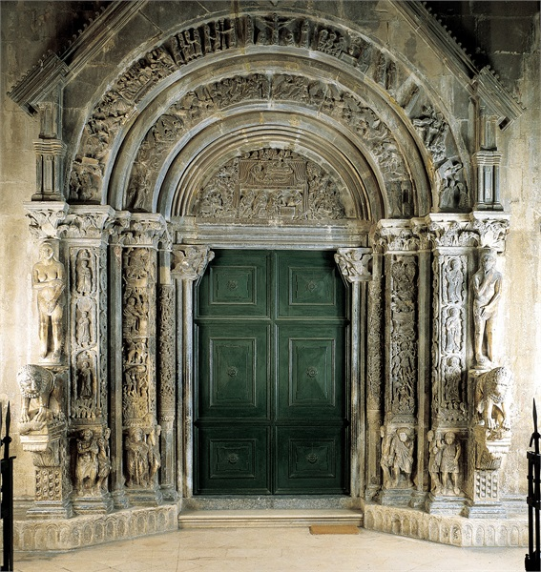
Historic City of Trogir
Povratak na kartu

Slide 5
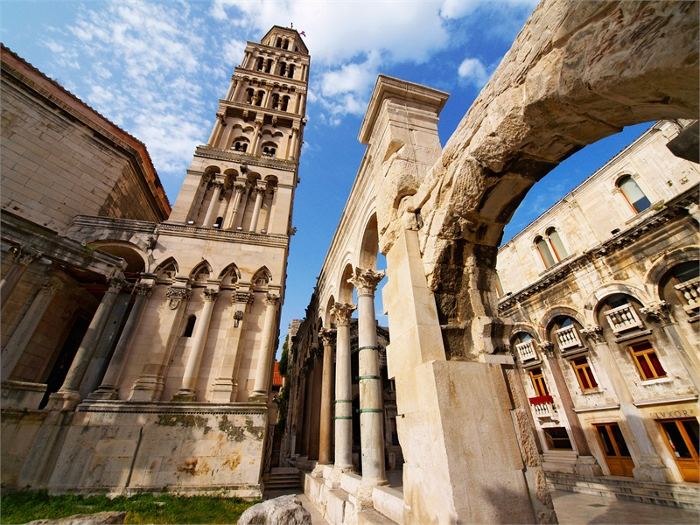
Historical complex of Split with the Palace of Diocletian
Povratak na kartu

Slide 6
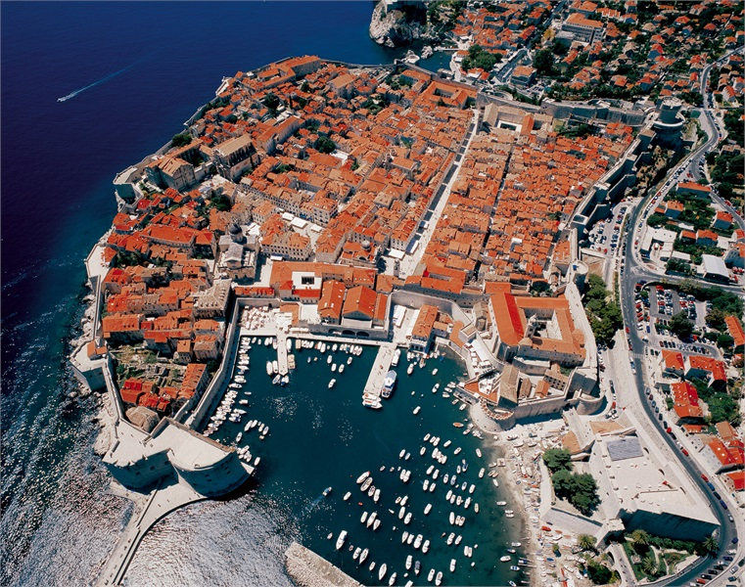
Old City of Dubrovnik
Povratak na kartu

Slide 7
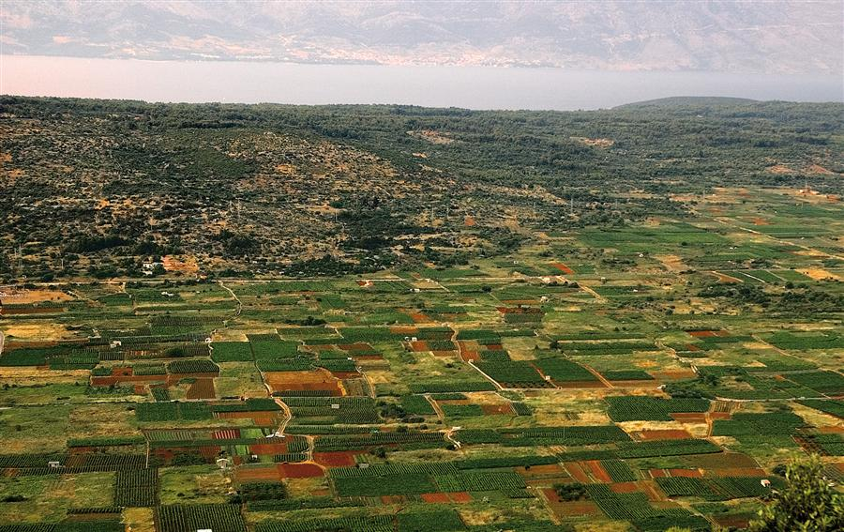
Stari Grad Plain
Povratak na kartu

Slide 8
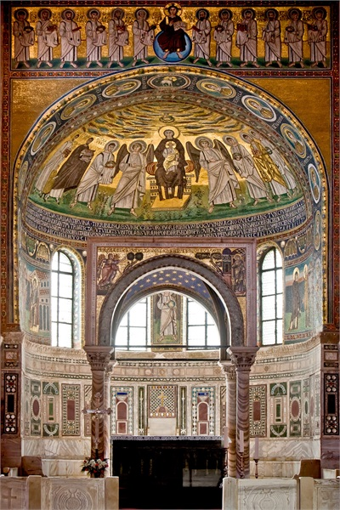
Episcopal Complex of the Euphrasian Basilica in the Historic Centre of Poreč
Povratak na kartu

